Slide 1
Lecture 3: Agile Software Development

Slide 2
Agility
An agile philosophy for software engineering stresses four key issues:
The importance of self organizing teams that have control over the work they perform
Communication and collaboration between team members and and between practitioners and their customers
A recognition that change represents an opportunity and
An emphasis on rapid delivery of software that satisfies the customers
Agile process models have been designed to address each of theses issues.

Slide 3
Agility
In modern software process, agility is very interesting, everyone is agile.
An agile team is capable of appropriately respond to changes
Changes in the software being built
Changes in the team members
Changes because of new technology
Changes in all kinds that may have an impact on the product etc.

Slide 4
12 principles of Agile alliance
The highest priority is to satisfy the customer through early and continuous delivery of valuable software
Welcome changing requirements
Deliver working software frequently
Business people and developer must work together daily
Build projects around motivated individuals
Conveying information through face to face conversassion among the development team
Working software is the primary measure of progress
Agile processes promote sustainable development
Continuous attention to technical excellence and good design enhances agility.
…….

Slide 5
Agile process
An agile software process is characterized by 3 key issues:
It is difficult to predict in advance which software requirements will persist and which will change
Construction is used to prove the design: For many types of software design and construction are interleaved.
Analysis, design, construction and testing are not as predictable (from a planning point of view) as we might like.
An agile software process must adapt incrementally. The iterative approach enables the customer to evaluate the software increment regularly. It provide necessary feedback to the software team

Slide 6
Agile Process Models
Some of the Agile Process Models:
Extreme Programming (XP)
Adaptive Software Development (ASD)
Dynamic Systems Development Method (DSDM)
Scrum
Feature Driven Development (FDD)
Extreme Programming (XP) is the most widely used agile process.

Slide 7
Why Agile development?: Rapid Software development
Rapid development and delivery is now often the most important requirement for software systems
Businesses operate in a fast–changing requirement and it is practically impossible to produce a set of stable software requirements
Software has to evolve quickly to reflect changing business needs.
Plan-driven development is essential for some types of system but does not meet these business needs.
Agile development methods emerged in the late 1990s whose aim was to radically reduce the delivery time for working software systems

Slide 8
Agile development
Program specification, design and implementation are inter-leaved
The system is developed as a series of versions or increments with stakeholders involved in version specification and evaluation
Frequent delivery of new versions for evaluation
Extensive tool support (e.g. automated testing tools) used to support development.
Minimal documentation – focus on working code

Slide 9
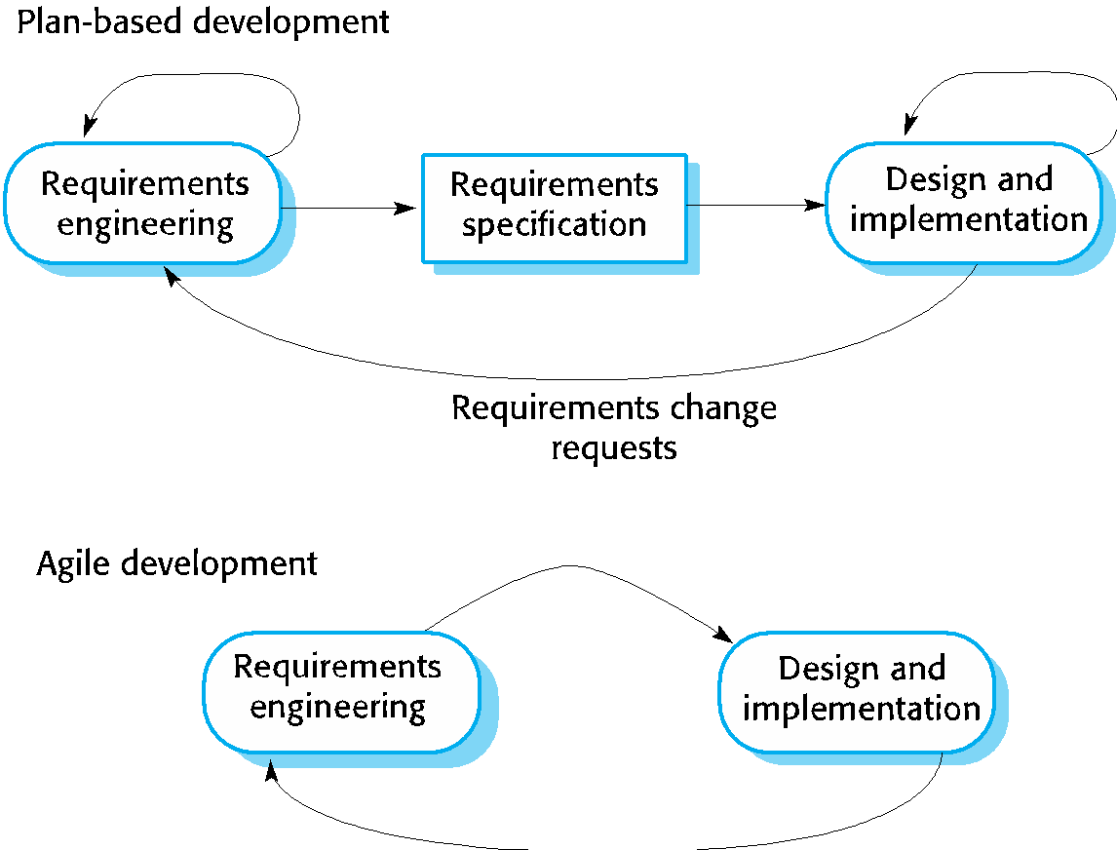
Plan-driven and agile development

Slide 10
Plan-driven and agile development
Plan-driven development
A plan-driven approach to software engineering is based around separate development stages with the outputs to be produced at each of these stages planned in advance.
Not necessarily waterfall model – plan-driven, incremental development is possible
Iteration occurs within activities.
Agile development
Specification, design, implementation and testing are inter-leaved and the outputs from the development process are decided through a process of negotiation during the software development process.

Slide 11
Agile methods
Dissatisfaction with the overheads involved in software design methods of the 1980s and 1990s led to the creation of agile methods. These methods:
Focus on the code rather than the design
Are based on an iterative approach to software development
Are intended to deliver working software quickly and evolve this quickly to meet changing requirements.
The aim of agile methods is to reduce overheads in the software process (e.g. by limiting documentation) and to be able to respond quickly to changing requirements without excessive rework.

Slide 12
Agile manifesto
We are uncovering better ways of developing software by doing it and helping others do it. Through this work we have come to value:
Individuals and interactions over processes and tools
Working software over comprehensive documentation
Customer collaboration over contract negotiation
Responding to change over following a plan
That is, while there is value in the items on the right, we value the items on the left more.

Slide 13
The principles of agile methods
Principle | Description
Customer involvement | Customers should be closely involved throughout the development process. Their role is provide and prioritize new system requirements and to evaluate the iterations of the system.
Incremental delivery | The software is developed in increments with the customer specifying the requirements to be included in each increment.
People not process | The skills of the development team should be recognized and exploited. Team members should be left to develop their own ways of working without prescriptive processes.
Embrace change | Expect the system requirements to change and so design the system to accommodate these changes.
Maintain simplicity | Focus on simplicity in both the software being developed and in the development process. Wherever possible, actively work to eliminate complexity from the system.

Slide 14
Agile method applicability
Product development where a software company is developing a small or medium-sized product for sale.
Virtually all software products and apps are now developed using an agile approach
Custom system development within an organization, where there is a clear commitment from the customer to become involved in the development process and where there are few external rules and regulations that affect the software.

Slide 15
Extreme programming (XP)
A very influential agile method, developed in the late 1990s, that introduced a range of agile development techniques.
Extreme Programming (XP) takes an ‘extreme’ approach to iterative development.
New versions may be built several times per day;
Increments are delivered to customers every 2 weeks;
All tests must be run for every build and the build is only accepted if tests run successfully.

Slide 16
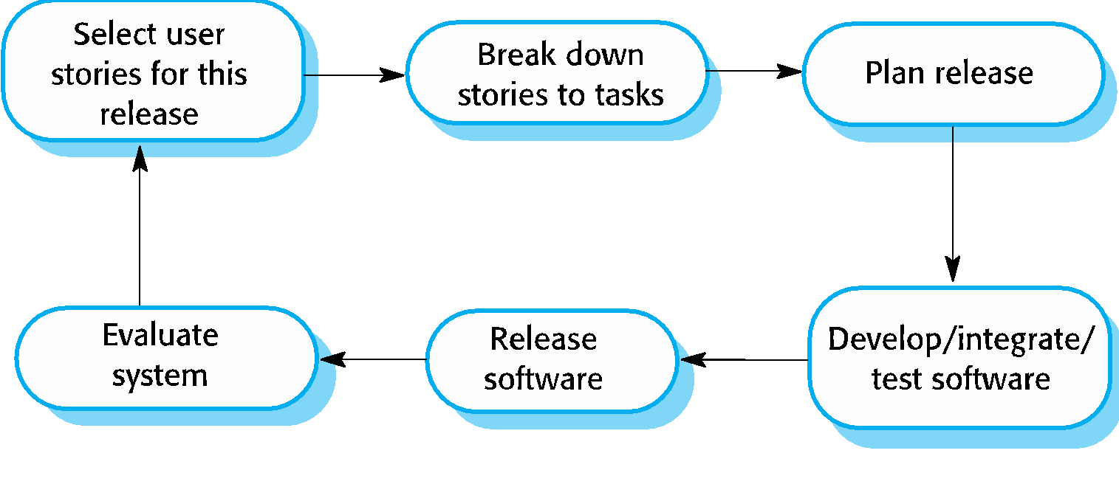
The extreme programming release cycle

Slide 17
Extreme programming principles/practices (a)
Principle or practice | Description
Incremental planning | Requirements are recorded on story cards and the stories to be included in a release are determined by the time available and their relative priority. The developers break these stories into development ‘Tasks’. See Figures 3.5 and 3.6.
Small releases | The minimal useful set of functionality that provides business value is developed first. Releases of the system are frequent and incrementally add functionality to the first release.
Simple design | Enough design is carried out to meet the current requirements and no more.
Test-first development | An automated unit test framework is used to write tests for a new piece of functionality before that functionality itself is implemented.
Refactoring | All developers are expected to refactor the code continuously as soon as possible code improvements are found. This keeps the code simple and maintainable.

Slide 18
Extreme programming practices (b)
Pair programming | Developers work in pairs, checking each other’s work and providing the support to always do a good job.
Collective ownership | The pairs of developers work on all areas of the system, so that no islands of expertise develop and all the developers take responsibility for all of the code. Anyone can change anything.
Continuous integration | As soon as the work on a task is complete, it is integrated into the whole system. After any such integration, all the unit tests in the system must pass.
Sustainable pace | Large amounts of overtime are not considered acceptable as the net effect is often to reduce code quality and medium term productivity
On-site customer | A representative of the end-user of the system (the customer) should be available full time for the use of the XP team. In an extreme programming process, the customer is a member of the development team and is responsible for bringing system requirements to the team for implementation.

Slide 19
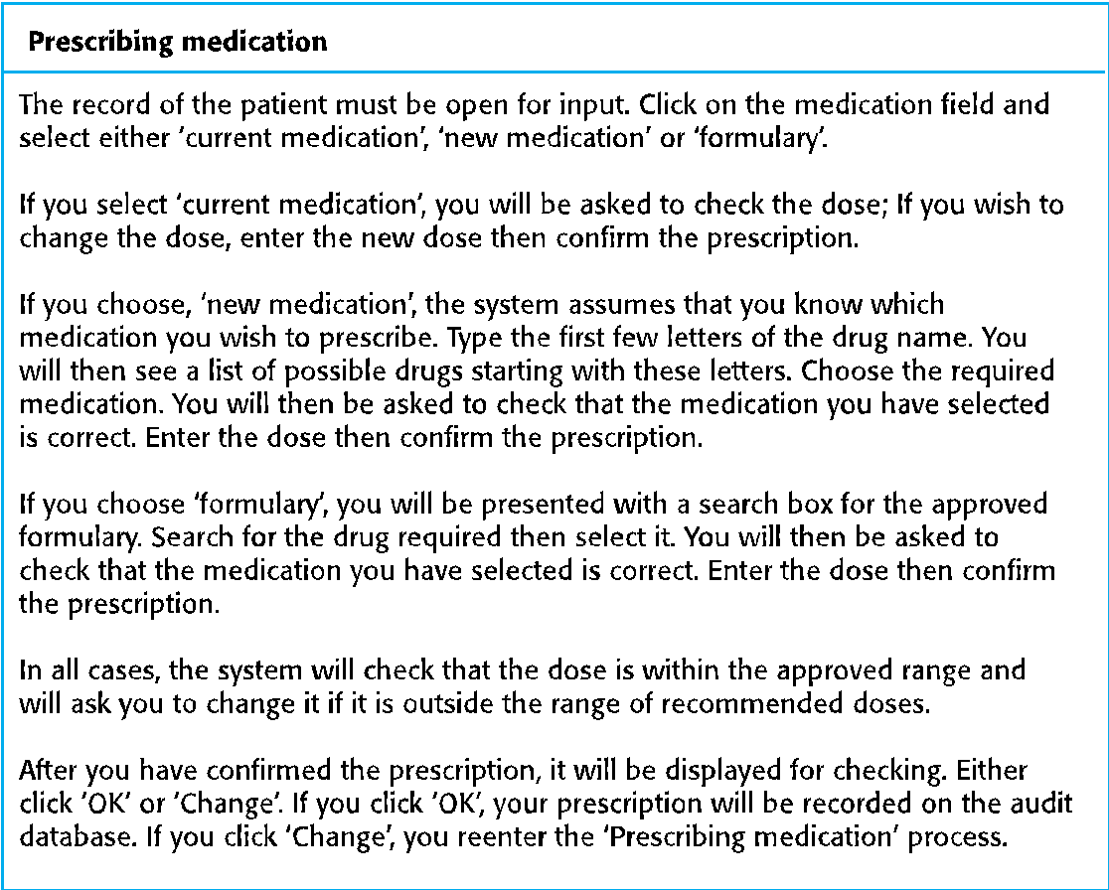
A ‘prescribing medication’ story

Slide 20
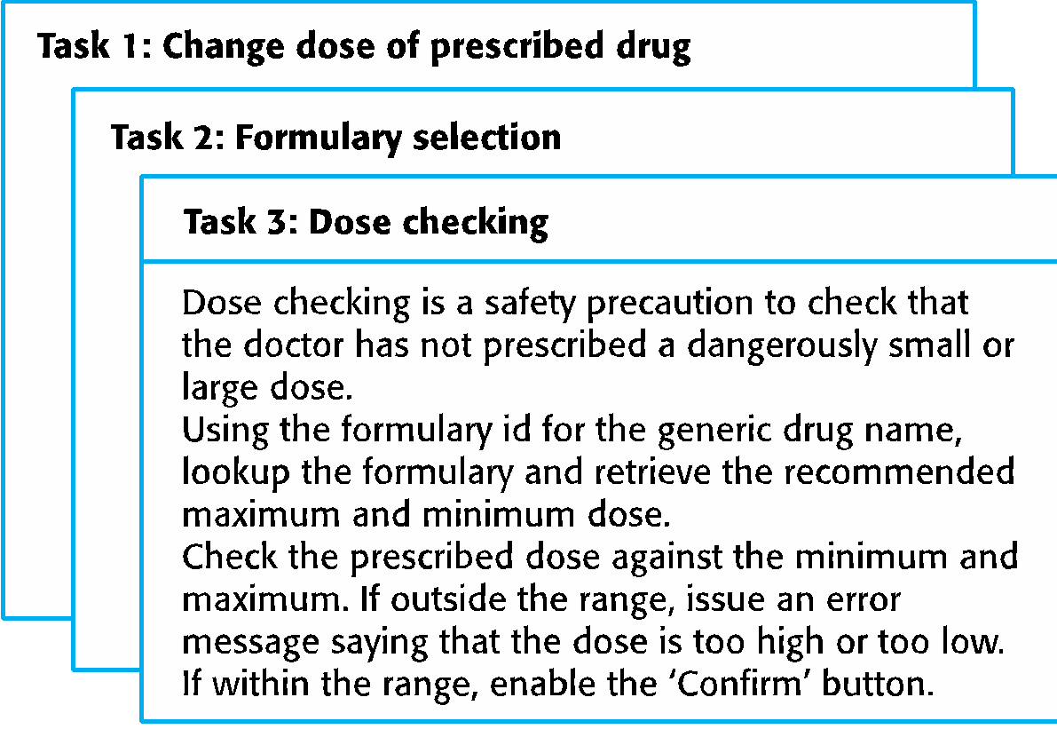
Examples of task cards for prescribing medication

Slide 21
Refactoring
XP, however, maintains that this is not worthwhile as changes cannot be reliably anticipated.
Rather, it proposes constant code improvement (refactoring) to make changes easier when they have to be implemented.
Programming team look for possible software improvements and make these improvements even where there is no immediate need for them.
However, some changes requires architecture refactoring and this is much more expensive.

Slide 22
Test-driven development (TDD)
Writing tests before code clarifies the requirements to be implemented.
Tests are written as programs rather than data so that they can be executed automatically. The test includes a check that it has executed correctly.
Usually relies on a testing framework such as Junit.
All previous and new tests are run automatically when new functionality is added, thus checking that the new functionality has not introduced errors.

Slide 23
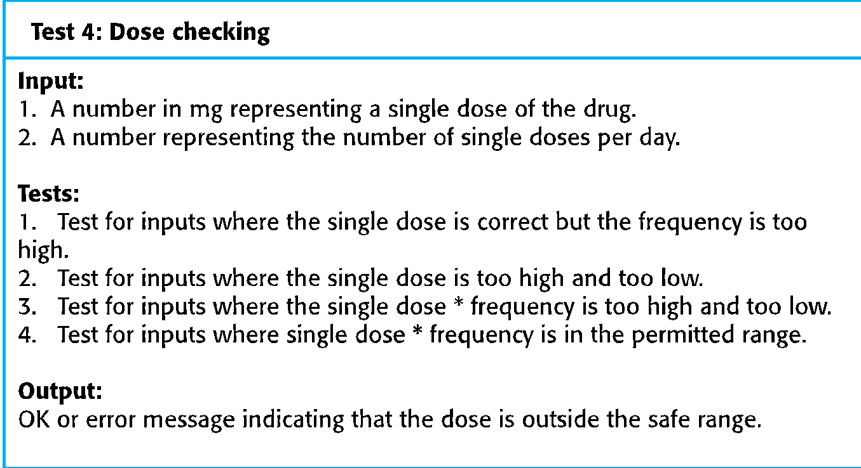
Test case description for dose checking

Slide 24
Test automation
Test automation means that tests are written as executable components before the task is implemented
These testing components should be stand-alone, should simulate the submission of input to be tested and should check that the result meets the output specification. An automated test framework (e.g. Junit) is a system that makes it easy to write executable tests and submit a set of tests for execution.

Slide 25
Scrum
Scrum
Scrum is an agile method that focuses on managing iterative development rather than specific agile practices.
There are three phases in Scrum.
The initial phase is an outline planning phase where you establish the general objectives for the project and design the software architecture.
This is followed by a series of sprint cycles, where each cycle develops an increment of the system.
The project closure phase wraps up the project, completes required documentation such as system help frames and user manuals and assesses the lessons learned from the project.

Slide 26
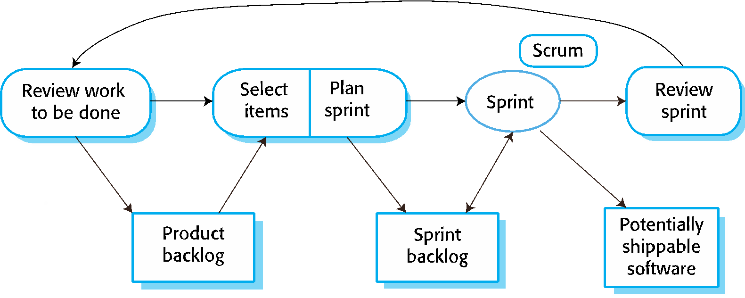
Scrum Sprint cycle

Slide 27
The Scrum sprint cycle
Sprints are fixed length, normally 2–4 weeks.
The starting point for planning is the product backlog, which is the list of work to be done on the project.
The selection phase involves all of the project team who work with the customer to select the features and functionality from the product backlog to be developed during the sprint.

Slide 28
Scrum benefits
The product is broken down into a set of manageable and understandable chunks.
Unstable requirements do not hold up progress.
The whole team have visibility of everything and consequently team communication is improved.
Customers see on-time delivery of increments and gain feedback on how the product works.
Trust between customers and developers is established and a positive culture is created in which everyone expects the project to succeed.

